Slide 1
Islamic Micro-Finance & CryptoCurrency
Dr Zareen Roohi Ahmed
Founder, IFCC
(Islamic Finance & CryptoCurrency Think Tank)
UK

Slide 2
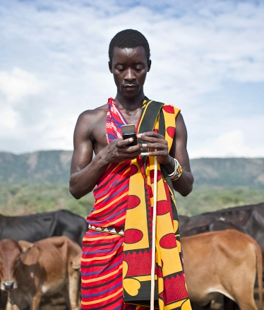
The Changing Face of Finance
World is moving towards becoming cashless and using cryptocurrency
Dubai, Bangladesh, India and other countries will be ‘cashless societies’ within the next 2-4 years
25%+ of Kenya’s GDP is through mobile payments e.g. M-Pesa
Even though the average pre-paid value is $1 Dollar

Slide 3
Cryptocurrency – the opportunity
Size of Islamic Economy is over 3 Trillion USD
700+ cryptocurrencies in existence
So far no Shariah Certified Cryptocurrency
Huge Potential in Muslim majority markets, Islamic Banks, Charities & the Halal Industries
Helps to promote equitable and fair business practices throughout the world
Most important: encourages unity, fosters good relations between cultures…

Slide 4
Let’s be clear….
“Islamic Finance is a system,
it is not religion.
Therefore it can be utilized & operated by both Muslim and Non-Muslim communities for Poverty Alleviation, Social & Economic Development.”
Zubair Mughal, Al Huda CIBE

Slide 5
How does Cryptocurrency apply to Islamic Finance & Islamic Microfinance?
Initial research on cryptocurrency seemed to tick all the right boxes:
Conforms with the prohibition of riba
Social benefits, positive externalities (Maslaha)
Mutual risk-sharing (Musharakah)
Value is determined by supply and demand
Fiat currency is born of riba
Whereas the quantity of digital currency in circulation increases at a predictable and steady rate;
Ultimate cap on quantity is hardcoded into programme (120 bn OneCoin)
So rather than being lent into existence at the whim of a person; New units of cryptocurrency help to maintain the security and stability of the cryptocurrency userbase and increase its value.

Slide 6
IFCC brought together leaders from the Islamic Finance & CryptoCurrency worlds
OneCoin was used as main case study due to centralised system
Experts & scholars agreed that cryptocurrency can be used as a viable currency according to Islamic principles if:
It is accepted by a mass of people
It begins to be used (to buy/trade) in the public domain
Islamic finance principles do not restrict the use of technology, so long as technology is ethical

Slide 7
As a result of this work OneCoin launched its 1st Islamic Finance Product – a saving facility
Shariah Compliant Option

Slide 8
OneCoin Leading the Way
Following audit & assessment of OneCoin, the first product was certified at the end of September.
Making OneCoin the first cryptocurrency to have a Shariah Certified Product - Coinsafe (saving facility)
Recommendations made to OneCoin on what needs to happen to make the rest of their systems Shariah Compliant too
They will have to Develop/change some elements within its systems to make them Shariah compliant
E.g. one of the recommendations is to have an account with an Islamic bank – so Muslim users can choose to send funds to an Islamic, interest free bank account *
Also made recommendations for new Shariah compliant products & systems
Entire process will take a few months, but shows they are listening to the needs of its Muslim audience and will do whatever it takes to make OneCoin accessible to everyone & become the most Shariah Complaint CryptoCurrency in the world

Slide 9
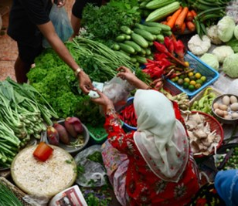
Islamic Microfinance & Cryptocurrency
Working with Al Huda CIBE to develop a fintech solution to alleviating poverty through a revolving model of microfinance using cryptocurrency
As cryptocurrency becomes more widespread (over next couple of years), so more of it will be utilised in place of tradtional currency

Slide 10
Cryptocurrency will be preferred currency
Islamic Microfinance
Fiat Currency
Crypto- Currency
Mobile Technologies

Slide 12
Let’s Talk…
Meet our diverse and skilled team
About how your organisation can get ahead of the game and start integrating cryptocurrency into its services
We’re looking for partners in all regions especially developing regions where we can help the unbanked.
If you’re new to cryptocurrency then do come to our workshop to learn more about how it works and get all your questions answered by our experts Kimmo & Tehsin

Slide 13
Islamic Micro-Finance & CryptoCurrency
Thank you
Dr Zareen Roohi Ahmed

